Slide 1
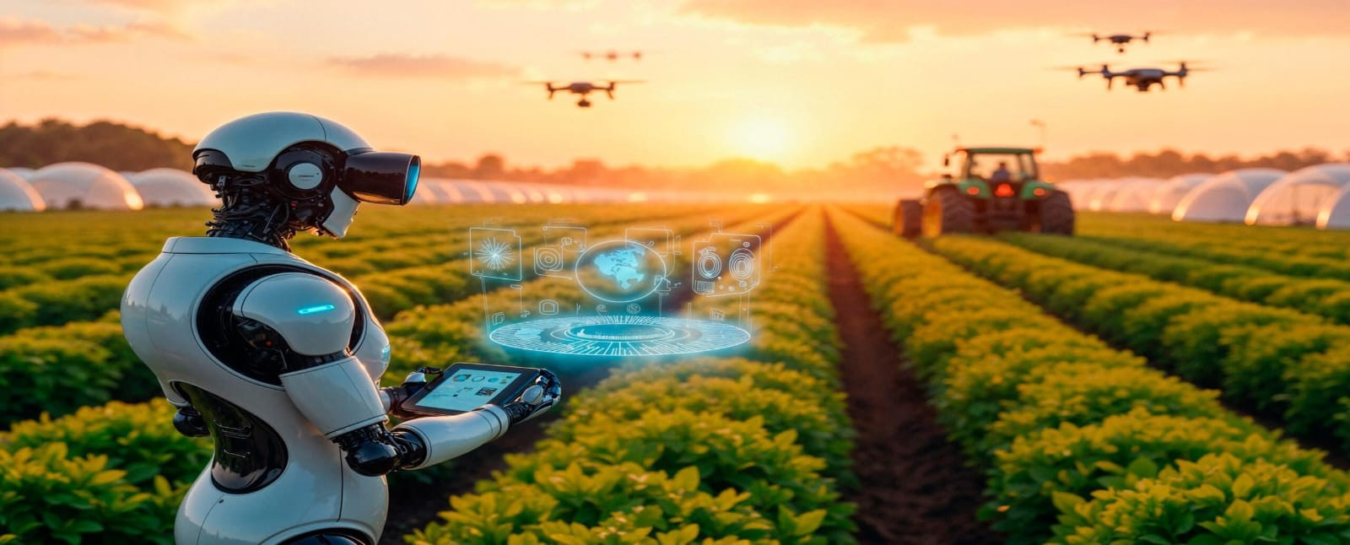
AI AGENT FOR SMART FARMING ADVICE

Slide 2
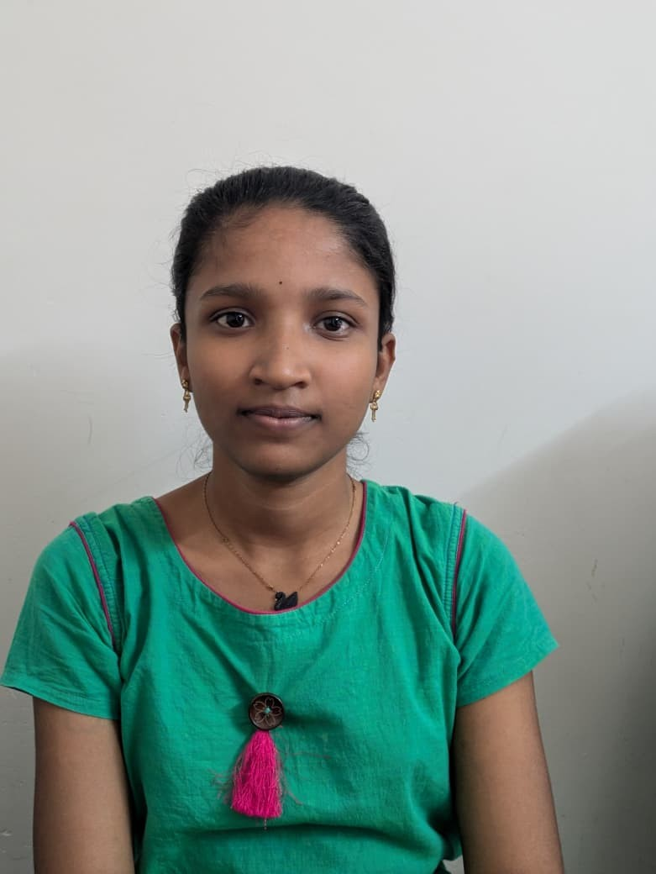
Project Tile – [AI Agent for Smart Farming Advice]
Domain of Project – [ Agriculture ]
Student Name | Recent Passport Photo | Email ID | Mobile number [WhatsApp]
Shruthi Pallerla |  | sruthiammu507@gmail.com | 8919724562

Slide 3
Problem Statement -
Problem Statement : – AI Agent for Smart Farming Advice
The Challenge:The Smart Farming AI Agent is an AI-based system that uses Retrieval-Augmented Generation (RAG) to provide real-time agricultural advice. It retrieves information from trusted sources such as weather services, agricultural departments, and market platforms. The agent helps farmers with crop selection, soil management, pest control, and weather forecasting. Farmers can ask questions in their local language and receive accurate, location-specific recommendations. It also provides current market prices to help farmers make better selling decisions. This technology improves productivity, reduces risks, and increases farmers' income.
The Objective :
Personalized Crop Recommendations – Suggest suitable crops based on soil type, weather conditions, season, and local farming practices.
Real-Time Agricultural Data Retrieval – Fetch and summarize information from trusted sources such as weather departments, agricultural databases, and market platforms.
Pest and Disease Management – Provide early warnings, preventive measures, and treatment recommendations for crop protection.
Market Price Intelligence – Deliver current mandi and market prices to help farmers make profitable selling decisions.
Multilingual Farmer Assistance – Enable farmers to interact with the system in their local language for easy access to information.

Slide 4
Technology Used
Tech Stack (Mandatory)
Use any one of the following approaches:
LangFlow + IBM watsonx.ai + Granite Models
IBM Cloud Agentic Lab with IBM Granite Models
Replicate with LangChain + RAG + IBM Granite Models
I used LangFlow + IBM watsonx.ai + Granite Models

Slide 5
Proposed Solution -
Proposed Solution – AI Agent for Smart Farming Advice
The proposed solution is an AI-powered Smart Farming Assistant that helps farmers make informed agricultural decisions using
real-time data and intelligent recommendations.
The system uses IBM Granite as the Large Language Model (LLM) and IBM Watsonx.ai to process farmer queries and generate personalized responses. Through Retrieval-Augmented Generation (RAG), the agent retrieves up-to-date information from trusted sources such as weather services, agricultural departments, soil databases, and market platforms.
Farmers can interact with the system in their local language through text or voice. The AI agent provides crop recommendations based on soil conditions, season, and climate, while also offering guidance on irrigation, fertilizer usage, pest control, and disease management. The system continuously monitors weather forecasts and sends alerts about adverse conditions that may affect crops.
A multi-agent architecture is used, consisting of a Weather Information Agent, Crop Recommendation Agent, Pest & Disease Advisory Agent, and Market Intelligence Agent. These agents work together to provide accurate, location-specific farming advice. A dashboard displays weather updates, crop information, soil insights, and current market prices, enabling farmers to make data-driven decisions that improve productivity, reduce risks, and increase income.

Slide 6
Langflow component Used -
1) Chat Input – Interface where users enter their queries, preferences, or meal details (text/voice/image).
2) IBM watsonx AI Agent - Processes user input using Granite models to generate personalized nutrition insights and recommendations.
3) Name of IBM Granite model - Granite-4.0-8B-Instruct → Fast, efficient for real-time diet recommendations
4) Chat output -Displays AI-generated responses such as diet plans, nutritional analysis, and health suggestions.
5) File component - Stores and retrieves user data, meal logs, and nutritional datasets for analysis and tracking.
6) A Weather Data Component – Retrieves real-time weather forecasts, rainfall predictions, temperature, and humidity data to support farming decisions. dd name of any other component used.
7)Crop Recommendation Component – Suggests suitable crops based on soil and climate conditions. Market Price Component – Fetches current mandi and market prices for crops.
Pest & Disease Detection Component – Provides alerts and treatment recommendations for crop diseases. Soil Analysis Component – Stores and analyzes soil data to recommend fertilizers and crops.
8) Crop Recommendation Component – Stores and analyzes soil, weather, and seasonal data to recommend the most suitable crops for farmers.

Slide 7
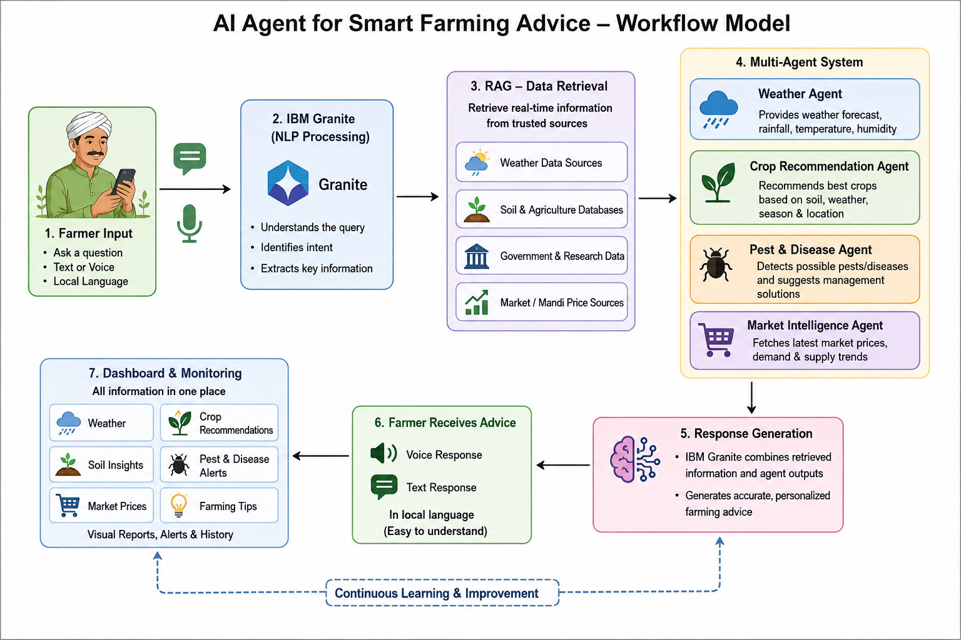
Langflow workflow -

Slide 8
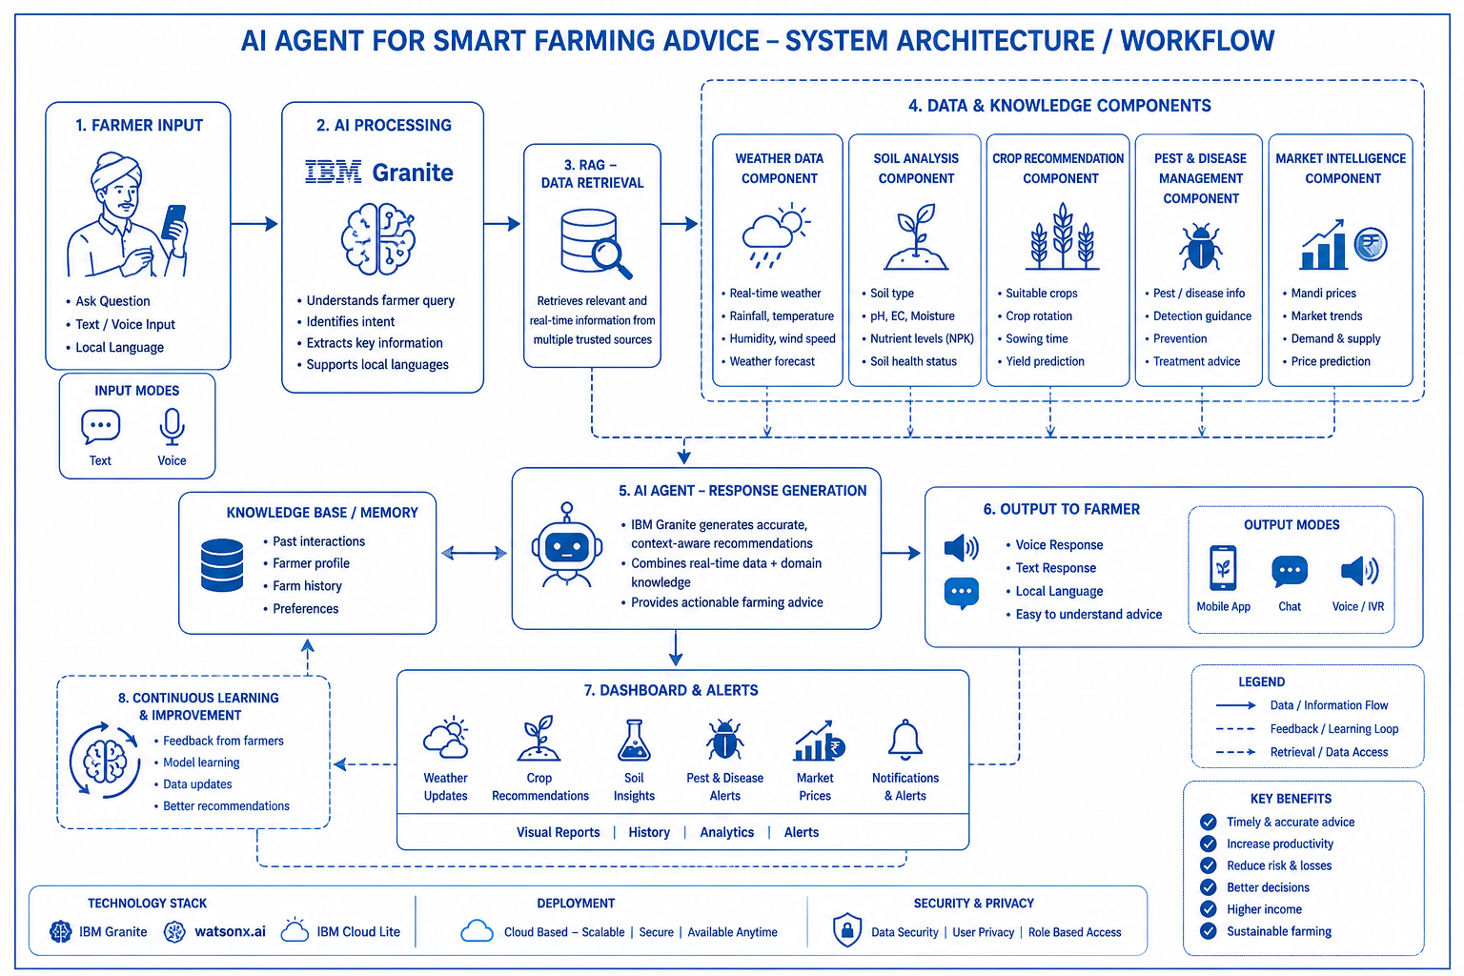
Architecture blueprint

Slide 9

Role of Agentic AI in the solution
Role of Agentic AI in Smart Farming Advice
Agentic AI enables the Smart Farming Agent to function as an intelligent, autonomous agricultural assistant rather than a simple question-answering system. Using IBM watsonx.ai and IBM Granite models, it coordinates multiple specialized agents to provide personalized and data-driven farming recommendations.
Each agent performs a specific role—such as retrieving weather information, recommending suitable crops, monitoring pests and diseases, and analyzing market prices—while working collaboratively. This multi-agent approach ensures efficient task execution and accurate agricultural guidance.
Agentic AI also provides context awareness by understanding factors such as soil conditions, crop type, location, season, and weather patterns to generate tailored recommendations for farmers. It supports real-time adaptation by continuously updating advice based on changing environmental conditions and new data sources.
Additionally, the agents communicate with one another, enabling better decision-making and comprehensive farming support. For example, weather forecasts can influence crop recommendations, while market trends can affect harvesting and selling decisions.
Overall, Agentic AI makes the system proactive, intelligent, and goal-driven, acting like a smart digital farming advisor that helps farmers improve productivity, reduce risks, optimize resources, and increase income through informed agricultural decisions.

Slide 10
Technology Used
Langflow platform -For designing and orchestrating multi-agent workflows visually
IBM Grainte model - for eg – ibm-granite-3-2-8b – For natural language understanding, reasoning, and personalization
IBM Cloud – It provides the infrastructure to build, deploy, and scale the Smart Farming Agent efficiently. IBM Cloud enables a reliable, secure, and scalable environment for agricultural applications.
RAG– Retrieves real-time data such as weather forecasts, soil information, crop guidelines, pest control measures, and market prices before generating accurate responses.
IBM Watsonx.ai - For model deployment, embeddings, and AI governance
Vector Database (FAISS/Chroma) – Stores agricultural knowledge, crop information, weather advisories, pest management data, and market insights as embeddings for efficient RAG-based retrieval.

Slide 11
Novelty and Uniqueness
The proposed Smart Farming stands out by combining Agentic AI, RAG, and personalization into a single intelligent system.
Multi-Agent Intelligence – Instead of a single chatbot, multiple specialized agents collaborate to deliver accurate and context-aware nutrition guidance.
RAG-Based Accuracy – Integrates real-time data retrieval with AI generation, reducing misinformation and ensuring trustworthy recommendations.
Hyper-Personalization – Tailors diet plans based on health conditions, cultural preferences, and fitness goals.
Real-Time Feedback Loop – Continuously adapts recommendations based on daily food logs and user behavior.
Multi-Modal Input – Supports text, voice, and image-based meal tracking for better usability.
Preventive Healthcare Focus – Goes beyond diet planning to provide disease-specific nutrition advice.
Scalable & Enterprise-Ready – Built on IBM watsonx.ai with IBM Granite models, ensuring reliability and governance.
This makes the solution a smart, adaptive, and proactive digital farming, not just a static diet recommendation tool.

Slide 12
Git Hub Link
· Please create public github repository (Enable Add README button while creating repository) with format –
Please test and Paste the working Github URL –
https://github.com/sruthiammu507-collab/-AI-Agent-for-Smart-Farming-Advice
Make sure you have Uploaded following three files into your github repository 1) app.json file , 2) yourproblemstatement.pdf file 3) your projectpresntation.pptx file 4)any other files
·
·
·

Slide 13
Future Scope
1. Precision Farming
AI agents will use data from soil sensors, weather stations, and crop monitoring systems to provide accurate recommendations for farming activities. They can determine the exact amount of water, fertilizer, and pesticides needed for each area of a field. This reduces resource wastage and lowers production costs. Precision farming helps improve crop quality and increases overall agricultural productivity. Farmers can make data-driven decisions instead of relying only on experience.
2. Real-Time Crop Monitoring
Future AI agents will continuously monitor crop health through sensors, drones, and satellite imagery. They can identify signs of diseases, pest attacks, water stress, and nutrient deficiencies at an early stage. Early detection allows farmers to take corrective actions before serious damage occurs. AI systems can send instant alerts and suggest suitable treatments. This leads to healthier crops and higher yields.
3. Weather-Based Decision Making
AI agents will analyze weather forecasts, rainfall patterns, temperature, humidity, and wind conditions in real time. Based on this information, they can advise farmers on the best time for sowing, irrigation, fertilizer application, and harvesting. Timely recommendations help reduce losses caused by droughts, floods, or unexpected weather changes. Farmers can better prepare for adverse conditions and protect their crops. This improves farm productivity and reduces climate-related risks.
·
·
·

Slide 14
THANK YOU

